Slide 1

Real-time Financial Fraud Detection with Modern Python
How to build production-grade fraud detection systems that make sub-second assessments on financial transactions while adversaries constantly adapt.
César Soto Valero
Data Scientist / ML Engineer
cesarsotovalero.net
Notes:
Hello everyone, my name is Cesar. I currently work as a Data Scientist and Machine Learning Engineer in the financial sector, and in this session I’m going to cover the topic of real-time financial fraud detection with Python.
This is a very exciting area to work in. Even though I’m not going to talk about AI and LLMs, this is still well-proven Machine Learning techniques that have been battle-tested in production.
So, I’m sure this session will be especially relevant for those of you interested in learning how real fraud detection systems are actually built and deployed.
And my promise is that by the end of this session, you will have a solid understanding of how to design production-grade fraud detection systems that make high-stakes decisions under both latency and adversarial pressures.
So let’s dive in!

Slide 2
In This Session
Problem framing
Decision-first metrics
Time-aware validation
Latency-aware modeling
Shipping & operations
Problem framing
Decision-first metrics
Time-aware validation
Latency-aware modeling
Shipping & operations
cesarsotovalero.net
Notes:
Here’s how this session is organized:
- First, we’re going to frame the problem from both a technical and a non-technical perspective. This part is about fraud detection and its specific challenges, such as class imbalance, label delay, adversarial behavior, and so on.
- Second, we’re going to talk about the right metrics for this kind of problem. I’ll not only cover the classic Precision and Recall, but also the area under the precision–recall curve, calibrating thresholds, and so on.
- Third, it’s also important to understand how these models are validated and enhanced with, for example, temporal splits, rolling cross-validation, etc.
- Fourth, we’ll look at the constraints for modeling. Latency, in this case, is a major constraint. We’ll also discuss which kinds of models perform best and when to use Deep Learning.
- And last but not least, we’ll talk about modern MLOps pipelines for model serving and operations.
So, le’t start with problem framing.

Slide 3
1. Problem Framing
Notes:
This context is necessary to understand the problem domain.

Slide 4



🏦Financial Institution
💵
transaction
request
💵
✅
Fraud Detection System
Legit Customer
Recipient
🏦Financial Institution
💵
transaction
request
❌
❌
Fraud Detection System
Fraudster
Recipient
cesarsotovalero.net
Notes:
Let me start with a very simplified overview of how this works.
In this case, you have a legit customer who sends a transaction request to a financial institution like a bank.
Let’s say the bank has a fraud detection system that uses business rules and machine learning
And then, based on the many variables like customer profile, the type of transaction, the recipient, and many other metric, the transaction is approved and everybody is happy.
On the other hand, if the transaction request is sent by a fraudster,
Then the fraud detection system should be able to decline the transaction.
In this way, the money never leaves the financial institution, the legit customers are protected, and the fraud never happens.
So, at a very high level, these are the two scenarios.

Slide 5

The Stakes Are Very High!
💸 Real Money, Realtime
🎯 Fraud Evolves Daily
Every transaction requires a decision in milliseconds. Delays mean lost revenue or unhappy customers.
Rule-based systems can't keep the pace with adversaries who iterate and adapt like well-funded startups.
😤 Trust Is Fragile
False positives block legitimate users, eroding trust faster than fraud costs money.
Notes:
So, it’s important to mention that in this particular context the stakes are very, very high.
Why?
- Because we’re talking about protecting real money from customers, and every transaction requires a decision in milliseconds. For financial institutions, every card payment, every transfer, or every login in the banking app is a chance to help a customer or a risk of dealing with a fraudster.
- Another challenge is that fraud patterns evolve quite rapidly. Fraudsters adapt faster than rule-based systems can keep up. They behave like well-funded startups: testing boundaries and trying to reverse-engineer the detection systems.
- And very importantly, the whole banking business is about trust, and as we know, trust is fragile. False positives frustrate legit customers and damage the reputation of financial institutions. There’s always the risk of blocking too many transactions, which leads to customers getting upset and abandoning the services.

Slide 6
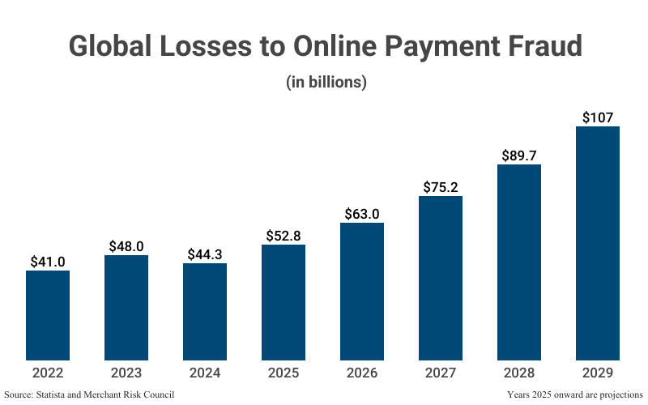
cesarsotovalero.net
Notes:
On the other hand, fraud is a big deal globally. Just for you to get an idea, the amount of money lost due to online payment fraud alone this year so far is estimated to be more than 50 billion dollars.
And all projections forecast an increase in the coming years.
This is partly because the number of online payment services keeps going up, and also because technically stopping fraud is very hard.

Slide 7



Why This Is Hard
Extreme Class Imbalance
Delayed Ground Truth
Active Adversaries
Fraud represents 0.1–2% of transactions in most systems. Finding needles in haystacks is the core technical challenge. Traditional accuracy metrics become meaningless.
Labels arrive days or weeks after decisions. Chargebacks and investigations take time. Training on outdated patterns while fraud tactics shift creates constant model drift.
Fraudsters deliberately probe your thresholds and test detection boundaries. They reverse-engineer your models through systematic experimentation, forcing constant adaptation.
cesarsotovalero.net
Notes:
Why is it hard?
- First, fraud events are rare. They represent between 0.1 and 2 percent of the total number of transactions in most financial systems, so searching for fraud patterns is like trying to find a needle in a haystack. This extreme class imbalance makes traditional machine learning metrics like accuracy meaningless.
- Second, labels arrive late into the froud reporting systems, sometimes weeks after the transaction happened, because it takes time for the human investigators to contact customers and confirm whether what happened was an actual fraud or not. This means the feedback loop gets delayed, and that the machine learning models inevitably train on outdated patterns.
- Third, this situation gives an advantage to the fraudsters. They are constantly testing the systems to bypass the guardrails, forcing the models to be in constant adaptation.
So, the problem of detecting fraud is about playing a very dynamic game in which we’re trying to figure out signals and patterns out of a few fraud cases, reasoning about delayed ground truth, and designing models and processes that can predict tactics that are evolving all the time.

Slide 8
2. Decision-First Metrics
Notes:
So, the first challenge is about using the right metrics.
Let’s talk about it.

Slide 9
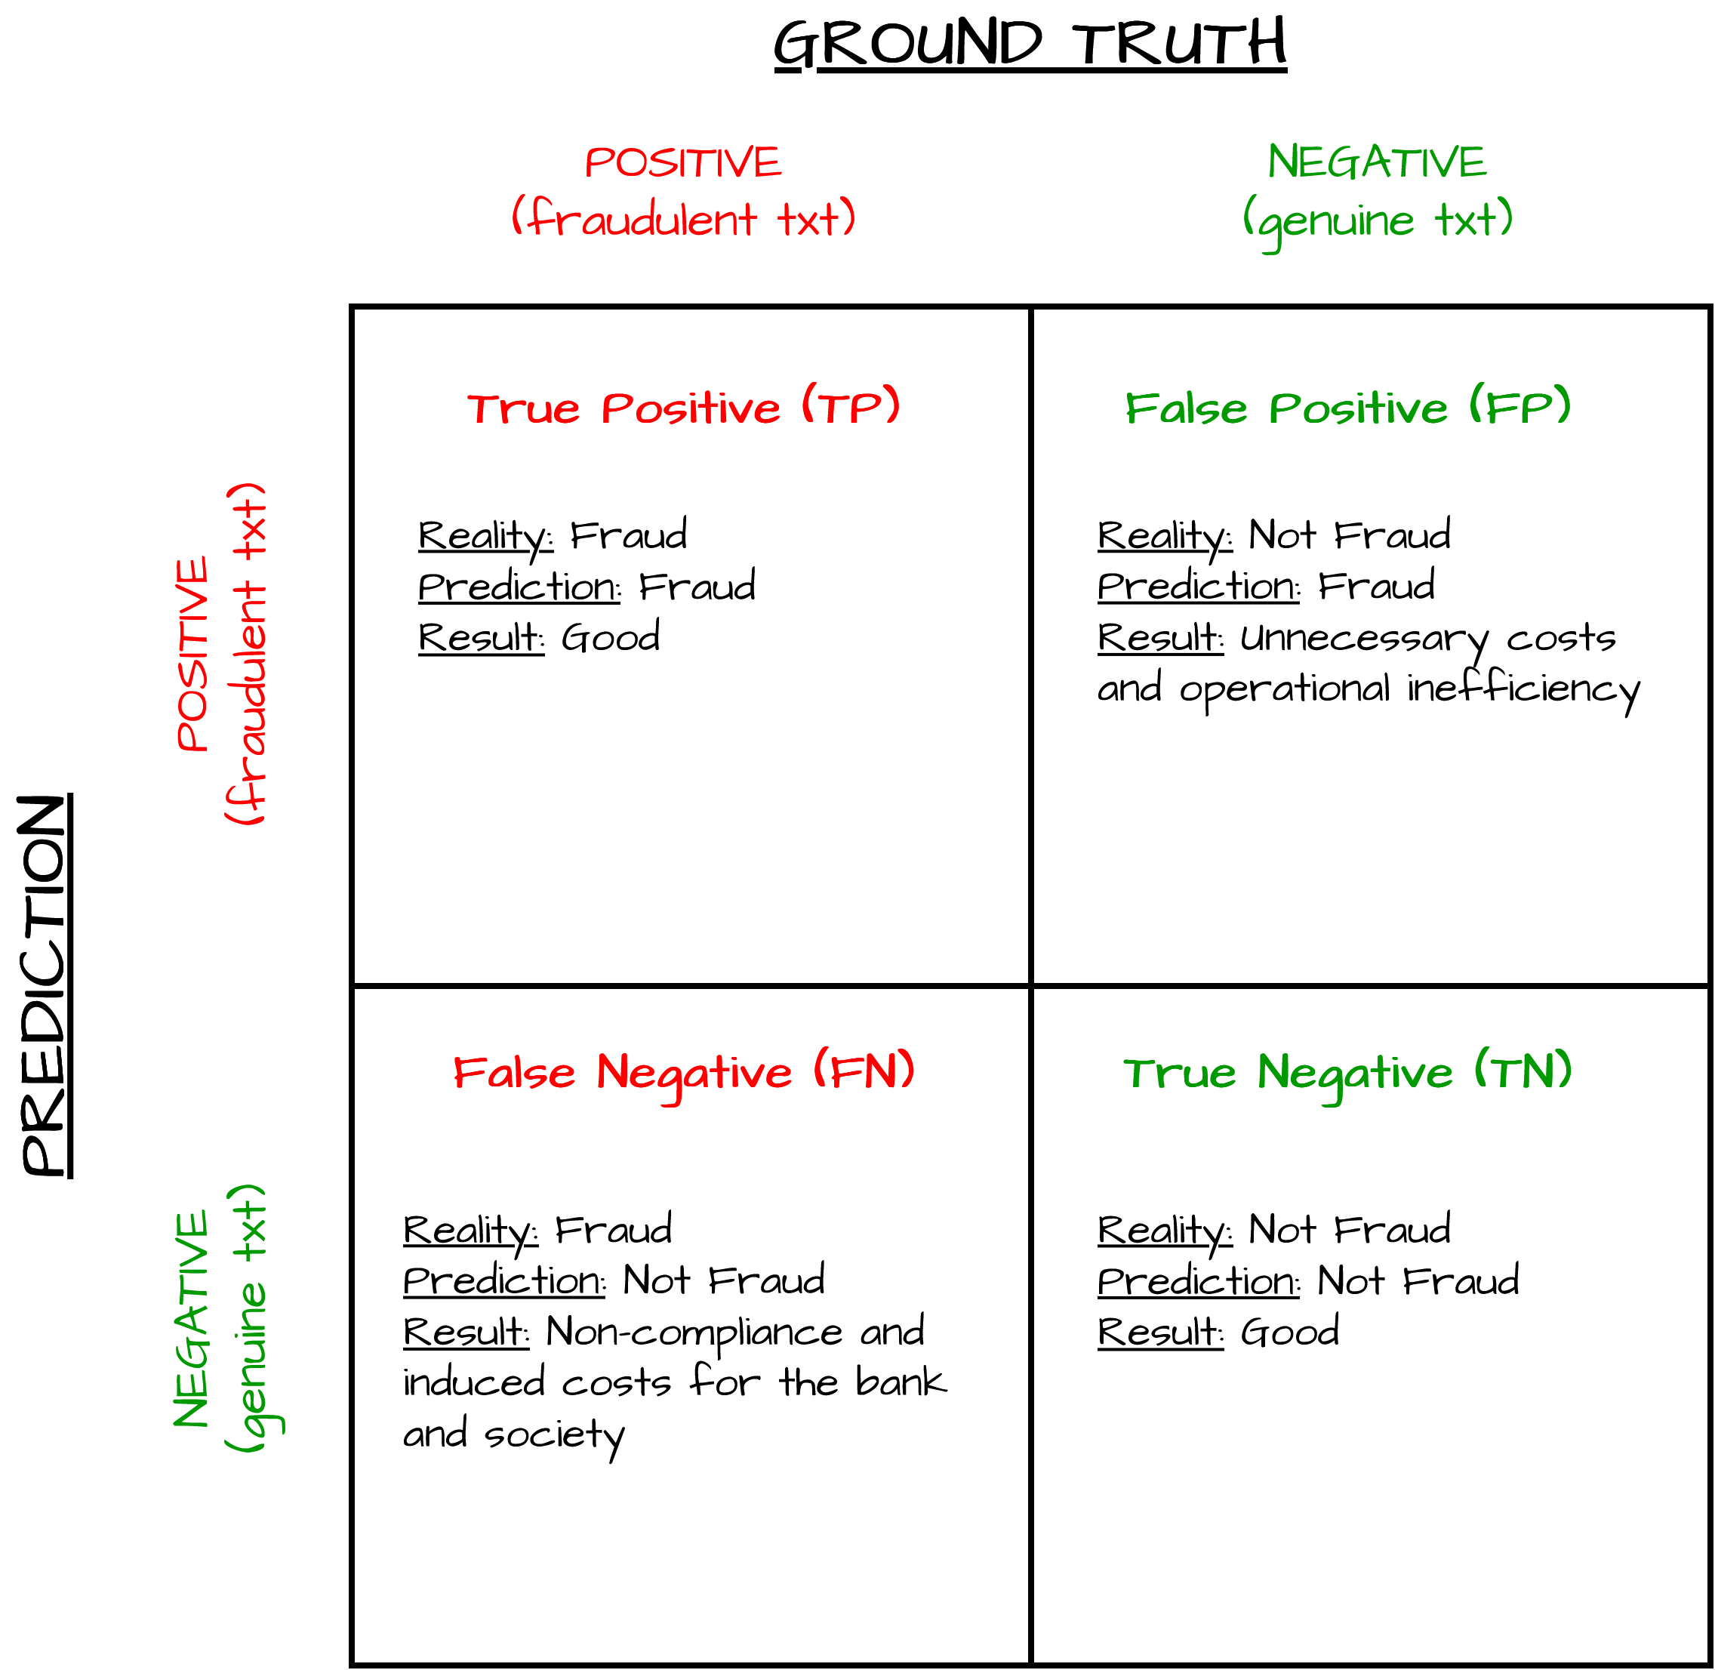

cesarsotovalero.net
Notes:
You’re probably familiar with this figure. It’s a confusion matrix, and it’s a widely used tool for summarizing and visualizing the performance of a classification model in a tabular format.
But I made this confusion matrix in particular to visualize the different outcomes for this problem.
- Most financial fraud detection systems generate a binary output: a prediction indicating whether a transaction is fraudulent or not. The positive class corresponds to the fraud transaction, the negative class corresponds to genuine transactions.
The interesting part here is that both the false positives and the false negatives have a cost associated with them for the business:
- For example, having a lot of false positives means unnecessary costs and operational inefficiencies because we’re essentially stopping transactions from legit customers.

Slide 10
cesarsotovalero.net
Notes:
You’re probably familiar with this figure. It’s a confusion matrix, and it’s a widely used tool for summarizing and visualizing the performance of a classification model in a tabular format.
But I made this confusion matrix in particular to visualize the different outcomes for this problem.
- Most financial fraud detection systems generate a binary output: a prediction indicating whether a transaction is fraudulent or not. The positive class corresponds to the fraud transaction, the negative class corresponds to genuine transactions.
The interesting part here is that both the false positives and the false negatives have a cost associated with them for the business:
- For example, having a lot of false positives means unnecessary costs and operational inefficiencies because we’re essentially stopping transactions from legit customers.

Slide 11
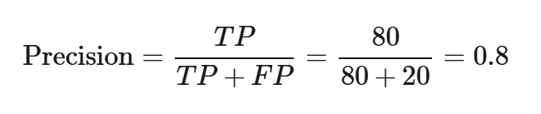
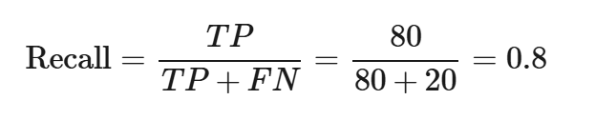
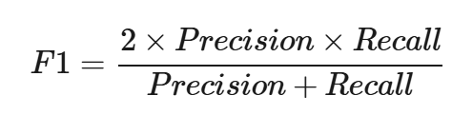
cesarsotovalero.net
Notes:
On the other hand, having false negatives means that the fraud detection system could not detect the fraud and, as a consequence, money was lost.
- And of course we have the standard machine learning metrics like Precision, Recall, and F1 Score, which are based on the confusion matrix.
- But it’s important to note that for this particular problem, Recall is the most important metric because it is the fraction of actual fraud cases that the model correctly predicts as fraud out of all actual fraud cases.
High Recall means having few false negatives, which is really good in fraud detection systems because missing a fraudulent transaction can lead to financial losses.

Slide 12
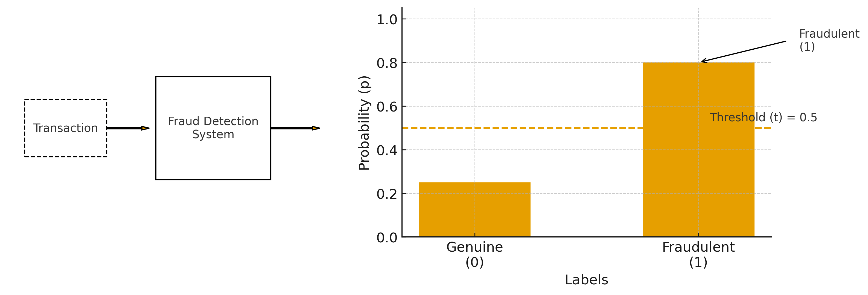
cesarsotovalero.net
Notes:
To control this, we use the idea of setting up a threshold, which is a mechanism for labeling a transaction depending on the probability assigned by the fraud detection system to determine whether the transaction is fraud or not.
- This way, we can usually increase Recall by lowering the detection threshold at the cost of Precision.

Slide 13
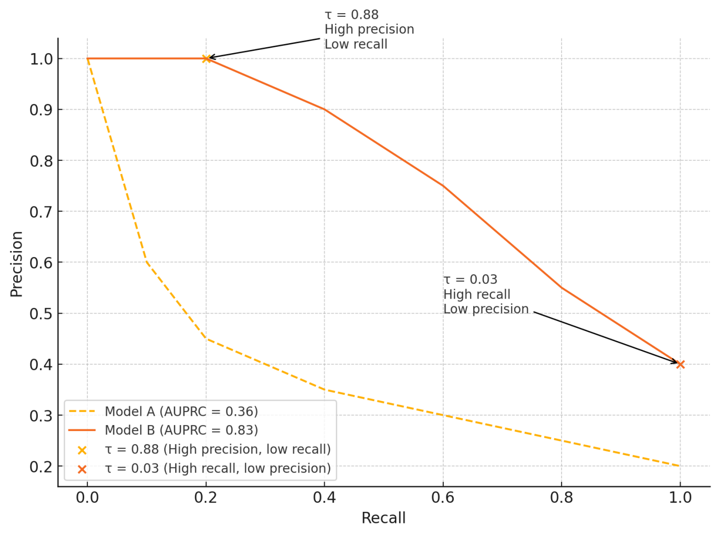
cesarsotovalero.net
Notes:
This idea is easier to appreciate by looking at the Area Under the Precision-Recall Curve (AUPRC).
As you can see, the figure plots Precision versus Recall and focuses on performance for the positive class (fraud), so it tells us how well the models catch fraud while keeping false positives low.
This metric is widely used for highly imbalanced problems like this because it summarizes very well the trade-off between Precision and Recall.
In this case, if you look at the Precision-Recall curves, it’s clear that Model B is better than Model A overall.
For Model B, different threshold values correspond to different trade-offs between Precision and Recall.
- For example, if we pick 0.88, we get high precision and low recall.

Slide 14
cesarsotovalero.net
Notes:
- If we pick 0.03, we get high recall and low precision.
So this choice is very specific to the business objectives and constraints.

Slide 15

from sklearn.metrics import precision_score, recall_score, precision_recall_curve
# y_true: 0 = genuine, 1 = fraud
# y_pred: model's predicted labels after thresholding probabilities
precision = precision_score(y_true, y_pred, pos_label=1)
recall = recall_score(y_true, y_pred, pos_label=1)
precision, recall, thresholds = precision_recall_curve(y_true, p_fraud, pos_label=1)
cesarsotovalero.net
Notes:
In Python, we can get all these metrics from the “scikit-learn” package.
It’s straightforward to compute precision and recall for a chosen threshold and to generate a precision-recall curve using the dedicated functions in “sklearn.metrics”.
This also makes it easy to experiment with different thresholds and evaluate the business impact of each Precision-Recall trade-off.

Slide 16
Extreme Class Imbalance
A model that labels everything as legitimate achieves 99.9% accuracy while catching zero fraud. Accuracy is a dangerous illusion when classes are imbalanced.
Precision and Recall Tell the Real Story
Thresholds Drive Business Impact
Precision measures how many alerts are actually fraud. Recall captures what percentage of fraud you catch. Both matter intensely for business outcomes.
Moving a decision threshold changes precision-recall balance and directly affects revenue, review costs, and customer experience. The threshold is a business lever, not just a technical parameter.
cesarsotovalero.net
Notes:
So, to summarize what we have seen regarding the metrics used for this highly imbalanced type of problem:
A key takeaway here is that in fraud detection systems where, for instance, 0.1 percent of transactions are fraudulent, a model that labels every transaction as legit will achieve 99.9 percent accuracy, but it provides zero business value in reality. So it’s very important to use the right metrics.
- That’s why precision and recall actually tell the real story about your model.
- It’s also important to be careful with the thresholds and threat them as first-class product decisions because they drive direct business impact.
In my experience, it’s good to have a version-control system for thresholds and all these metrics. It’s also good to maintain segment-specific thresholds because, for example, new users may need stricter settings than long-time customers. And monitor the thresholds weekly.

Slide 17
3. Time-Aware Validation
Notes:
So, now let’s talk about validation and the problem of delayed ground truth.

Slide 18
Delayed Ground Truth
Notes:
This is related to how and when we train our model.

Slide 19
Delayed Ground Truth
Temporal Train/Val/Test Splits
Never randomize timestamps. Train on past data, validate on near-future, test on held-out future. Respect time's arrow.
1
Notes:
When working with fraud detection, the ground truth arrives with a delay, so the way we split data becomes critical. Here, we should never randomize timestamps. We should train on past data only, validate on the near future, and test on a held-out future. The idea is simple: just respect the direction of time. Because if the model ever sees future information during training, the evaluation then becomes meaningless.

Slide 20
Delayed Ground Truth
Temporal Train/Val/Test Splits
Never randomize timestamps. Train on past data, validate on near-future, test on held-out future. Respect time's arrow.
1
2
Rolling Windows with Safety Gaps
Use sliding time windows that mimic production deployment. Add gaps between train and validation to simulate label delay.
Notes:
With delayed labels, even temporal splits are not enough. Production systems make decisions today, but the true labels might arrive weeks later. To simulate this, we use rolling time windows that slide forward exactly as a deployed model would. We also add safety gaps between training and validation to mimic the label delay and avoid contaminating the evaluation with information the model would not have at prediction time.

Slide 21
Delayed Ground Truth
Temporal Train/Val/Test Splits
Strictly Prevent Leakage Across Time
Never randomize timestamps. Train on past data, validate on near-future, test on held-out future. Respect time's arrow.
Future information must never leak into training. One timestamp error invalidates all results and creates false confidence.
1
2
3
Rolling Windows with Safety Gaps
Use sliding time windows that mimic production deployment. Add gaps between train and validation to simulate label delay.
Notes:
Finally, we must enforce strict controls so that no future information leaks into training. A single timestamp error can artificially inflate performance and create false confidence. In fraud detection, this is a classic pitfall: leakage makes the offline metrics look great, but the model collapses the moment it hits production.

Slide 22
Delayed Ground Truth
Temporal Train/Val/Test Splits
Strictly Prevent Leakage Across Time
Never randomize timestamps. Train on past data, validate on near-future, test on held-out future. Respect time's arrow.
Future information must never leak into training. One timestamp error invalidates all results and creates false confidence.
1
2
3
Rolling Windows with Safety Gaps
Use sliding time windows that mimic production deployment. Add gaps between train and validation to simulate label delay.
💡
Remember: Random splits give you optimistic metrics that collapse in production. Time-based validation predicts real performance.
Notes:
The takeaway here is to never randomly split the training dataset, and use time-based validation instead to predict real model performance.

Slide 23
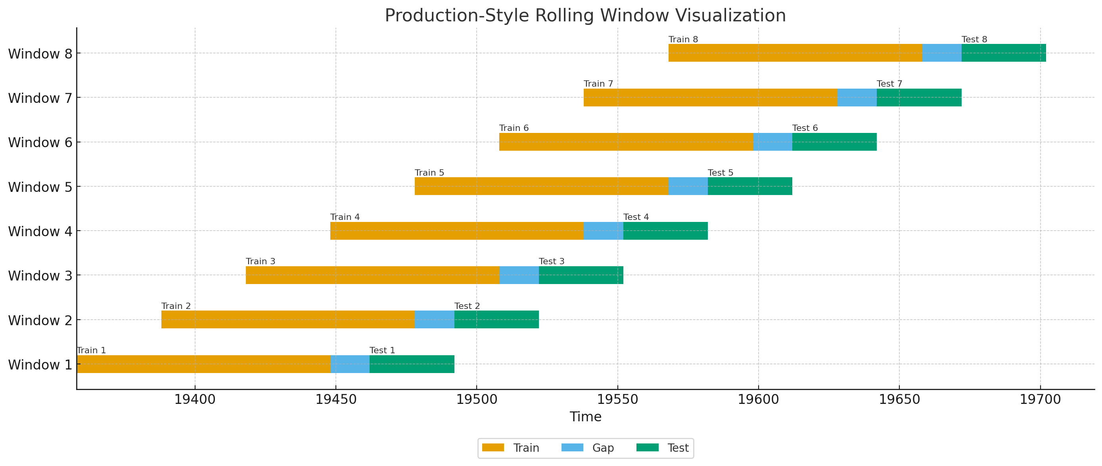
cesarsotovalero.net
Notes:
Here’s a visualization of how rolling windows looks in production, for real.
The y-axis are the rolling windows, the x-axis represents the timestamps, and as you can se each training window is separated from its test window by a safety gap in order to take into account the label delay.

Slide 24
4. Latency-Aware Modeling
Notes:
Now, I want to talk about the challenge of latency, which is he time it takes for the system to process a transaction and make an inference

Slide 25
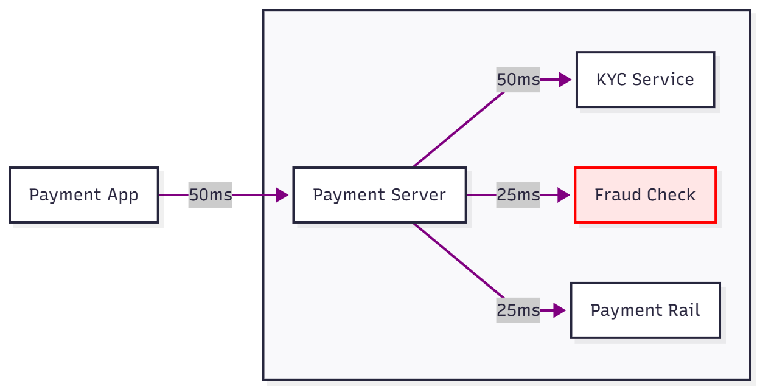
Latency
cesarsotovalero.net
Notes:
Keeping latency low is crucial for real-time payment systems. Fraud models not only need to have good statistical performance but also must operate quickly enough to be used in practice.
It’s important to realize that the fraud check is only one part of the payment service.
In this figure, for example, the Payment Server dispatches parallel calls to the KYC Service, the Fraud Check, and the Payment Rail, but the transaction can only complete once the slowest of these services responds (the KYC Service in this example). Even though the Fraud Check takes just 25 ms, any fluctuation (such as a network issue or a slow third-party response) can bottleneck the entire flow. That’s why latency is a system-wide risk amplifier.

Slide 26
Latency Budgets: Rules vs ML
<1ms
10-200ms
~
Rule-Based Systems
ML Model Inference
Hybrid Architecture
Blazingly fast, deterministic, explainable. Perfect for known patterns and hard constraints like blocklists or velocity checks.
Gradient-boosted trees typically run in tens of milliseconds. Neural networks can reach 100–200ms depending on complexity and infrastructure.
Blend rules for instant failsafes and ML for incremental lift. Rules catch obvious fraud at <1ms, models score the nuanced middle at acceptable latency.
cesarsotovalero.net
Notes:
There are three latency budgets you can think of.
- First, rule-based systems, super fast, deterministic and explainable.
- Second, machine learning models for which you take into account the inference time which is tide to the family of models used for training. For example, gradient-boosted trees typically run in millisecons and neural networks reach between 100 and 200 ms depending on complexity and infrastructure.
As you see, there is a big difference between both.
- In practice, the best-performing systems use a hybrid approach. They use rules to catch the obvious fraud cases, and models for more complex fraud scenarios.
- This way, you get the best of both worlds: instant reactions for high-risk events and smarter decisions for everything else, all within acceptable latency.

Slide 27
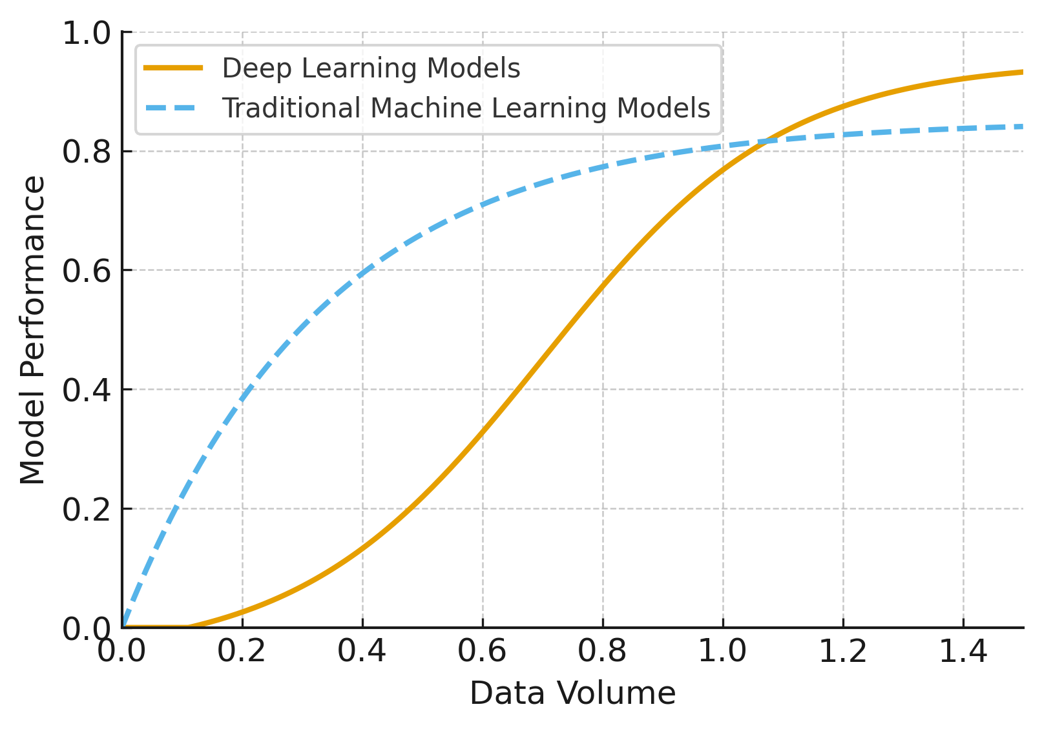
cesarsotovalero.net
Notes:
So, when it comes to choosing between deep learning or traditional machine learning model, it’s important to recall that model choice is a function of data volume.
- As you know, traditional ML works great when data is limited, but deep learning scales better with volume.
But in fraud detection, we also need to consider latency.
A model that is slightly better than another buts too slow for real-time assessment can be worse than a faster model with marginally lower performance.

Slide 28
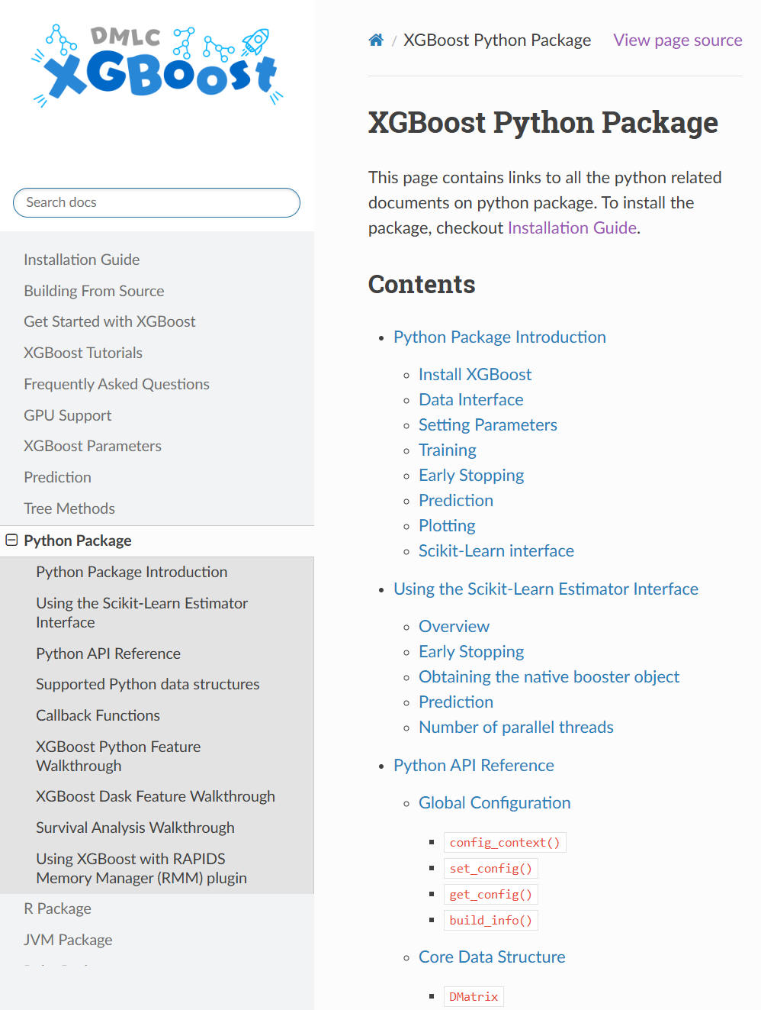
Start Strong With XGBoost
Why XGBoost Shines on Tabular Data
Handles heterogeneous features naturally without complex preprocessing
Fast inference fits realtime latency budgets with sub-100ms predictions
Interpretable feature importances and tree structures support debugging and stakeholder trust
Robust to missing values and outliers common in production fraud data
Pro tip: Start here before exploring deep learning. XGBoost delivers 80% of the value with 20% of the complexity.
Notes:
So, I definitely recommend starting with XGBoost, which is a great model for tabular data.
The Python package is fantastic, very straightforward to use.
It has many useful features for fraud detection, it’s robust to missing values, outliers, and overall it’s the standard choice for production ready fraud detection systems.

Slide 29

When to Add Deep Learning
Deep learning shines when other models hit a ceiling. If the feature space is sparse and high-cardinality, then tabular architectures like TabNet or FT-Transformer can capture complex patterns that gradient boosting misses.
Sparse, high-cardinality features benefit
Embeddings compress categorical explosions into dense representations, enabling models to learn nuanced entity relationships.
Learn interactions automatically
Deep architectures discover feature crosses without manual engineering, reducing technical debt and iteration cycles.
Validate gains against latency budget
Measure P99 inference time in production. If your scoring SLA is 50ms, confirm DL delivers ROI before scaling.
Notes:
The question, then, is when to use deep learning.
- As I mentioned before, deep learning shines when traditional models hit a ceiling. If the training data has high cardinality, such as device hashes, text metadata, or sequences, then architectures like TabNet or FT-Transformer are well suited for this task.
- Tabular deep learning or embedding layers can learn complex interactions by compressing these categorical explosions into dense representations, enabling the models to learn more nuanced entity relationships.
- Deep learning is also used today to discover business rules and generate features for machine learning models automatically. This is currently a very active research direction.
- That being said, it’s very important to keep an eye on inference latency and training cost when deploying deep learning models in production, especially when it comes to SLAs (or service level agreements), which are critical for the business.

Slide 30
5. Shipping & Operations
Notes:
Now, moving on to the last part, which is crucial: shipping and operations. As you know, building a great fraud detection system is worthless if it cannot be deployed and maintained easily in production.

Slide 31
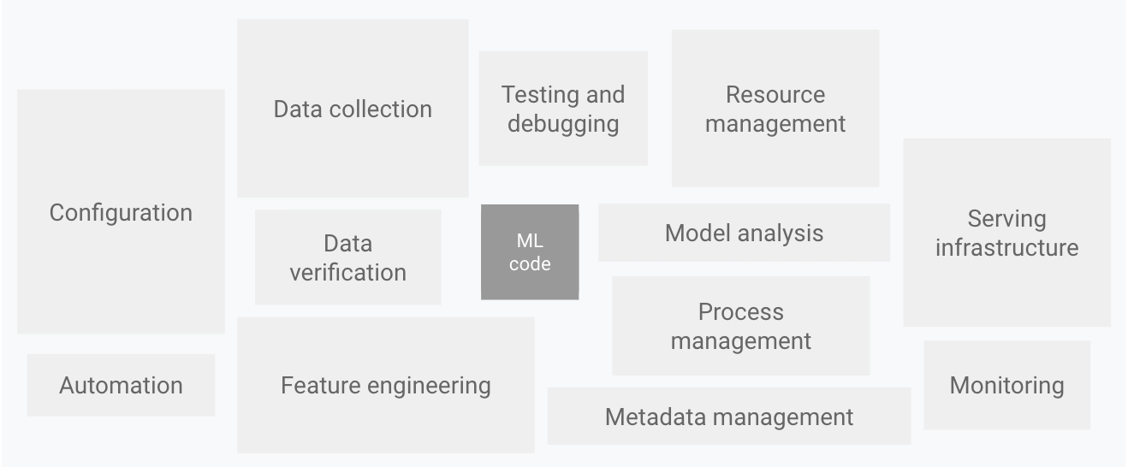
Source: https://docs.cloud.google.com/architecture/mlops-continuous-delivery-and-automation-pipelines-in-machine-learning
cesarsotovalero.net
Notes:
- And indeed, only a small fraction of a real-world Machine Learning system is composed of the Machine Learning code.
The required surrounding elements are vast and complex: Configuration, Automation, Data collection, Monitoring, Infrastructure, etc.

Slide 32
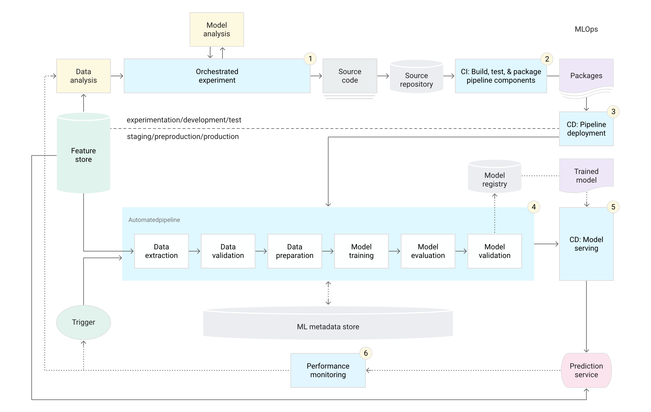
Source: https://docs.cloud.google.com/architecture/mlops-continuous-delivery-and-automation-pipelines-in-machine-learning
cesarsotovalero.net
Notes:
The following figure is a schematic representation of an automated CI/CD ML pipeline
- As you can see, the model analysis part is very small in comparison to the rest of the MLOps pipeline.
This figure is just to give you an idea of the complexity associated to maintaining this type of system.
You will need things like deployment services, a model registry, feature stores, an orchestrator for the machine learning pipeline, and many more.

Slide 33

From Notebook to Service
Production fraud detection demands more than a trained model. The gap between research code and a resilient service is wide.
1
2
Small, testable scoring core
Package model plus preprocessors
Isolate inference logic into a pure function: features in, prediction out. Unit test edge cases (e.g., null fields, out-of-vocabulary tokens, schema drift).
Bundle your serialized model with feature transformers, scalers, and encoders. Version everything together to prevent train-serve skew.
3
Serve behind a FastAPI endpoint
Wrap your scoring function in a lightweight REST API. FastAPI provides async support, automatic docs, and validation, which is critical for uptime and debugging.
Notes:
- So, typically you will start with a Jupyter notebook, then transition to a Python project with small functions and unit tests.
- Then, you package the model and the preprocessors, it’s important to make sure that the are identical online and offline.
- And for the prediction service, you can expose a FastAPI endpoint that accepts a transaction payload and returns a score plus decision metadata, for example the threshold used, he features, or the version of the model that is being used in production. It’s also important to keep the container small and also enforce input contracts with schema validation.

Slide 34


Serving Patterns That Scale
No single serving architecture fits every fraud use case. Match your pattern to transaction velocity, latency requirements, and operational complexity. Hybrid approaches often win in production.
Batch scoring for nightly sweeps
Online scoring for checkout flows
TorchServe or TFServing when needed
Score historical transactions offline. Perfect for investigating past fraud rings or recomputing risk for dormant accounts (no real-time pressure).
Synchronous prediction at transaction time. Requires sub-100ms P99 latency. Cache aggressively, use feature stores, and pre-warm models.
Leverage framework-native serving for GPU inference, model versioning, and A/B testing.
cesarsotovalero.net
Notes:
I also want to remark that there’s no silver bullet here, no single architecture fits every use case.
- But in my experience, it’s good practice to support both batch and online scoring.
- I also recommend to start simple with FastAPI, use feature stores or cached lookups for high-latency attributes.
- And if you decide to go with deep learning then definitely leverage the framework-native serving for GPU inference.

Slide 35

Patterns That Survive Reality
Fraud detection in production is a systems problem, not just a modeling problem. The best ML model fails if it can't ship, scale, or adapt.
Decide for cost, not vanity scores
Optimize for business impact (false positive costs, analyst capacity, customer friction). Precision-recall tradeoffs are product decisions.
Validate in time, always
Temporal cross-validation prevents overfitting to old fraud patterns. Adversaries evolve and your evaluation strategy must reflect that reality.
Ship with guardrails, monitor relentlessly
Use a hybrid approach, add complexity to the model only if necessary, and stick to MLOps good practices. Observability is not optional.
Notes:
As takeaways, I would like to let with some patters and good practices.
First of all, it’s always good to remember that fraud detection is an adversarial domain with real money and real latency constraints. It’s also important to remark that fraud detection in production is a systems problem, not just a modeling problem. The best Machine Learning model you can think of will fail if you cannot ship it to production.
So optimize for business impact instead of accuracy.
Validate on time, calibrate scores, and again choose models that you could evaluate well using temporal cross-validation to prevent overfitting.
Ship small, with guardrails. Take into account that it’s not just about the model or the business rules, there’s a whole MLOps pipeline that is necessary when building this systems for real. And of course observability is not optional.

Slide 36
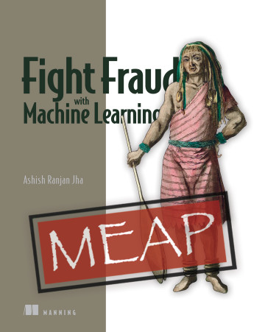
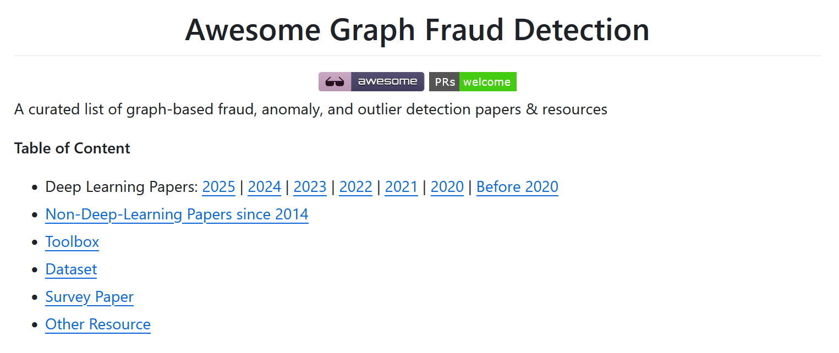
Recommended Resources
“Fight Fraud with Machine Learning”, MEAP book by Manning
https://github.com/safe-graph/graph-fraud-detection-papers/
cesarsotovalero.net
Notes:
Finally, I want to share two recommended resources if you want to dive deeper into this topic:
- First, the book “Fight Fraud with Machine Learning,” published by Manning. It will give you a solid foundation.
- And second, this excellent GitHub repository, “graph-fraud-detection-papers,” which contains a list of the latest papers in the field.
With this, I conclude my presentation.
Thank you very much for your attention, and I’ll be happy to take your questions if there’s time left for it. Otherwise, I can answer your questions in the chat. Thank you again.

Slide 37
Q&A
cesarsotovalero.net
Notes:
So now I’ll go through my current Pyton toolbox.

